Slide 1
CENG-317 Project
Mi Nam Alcantara (n01451260)
2023

Slide 2
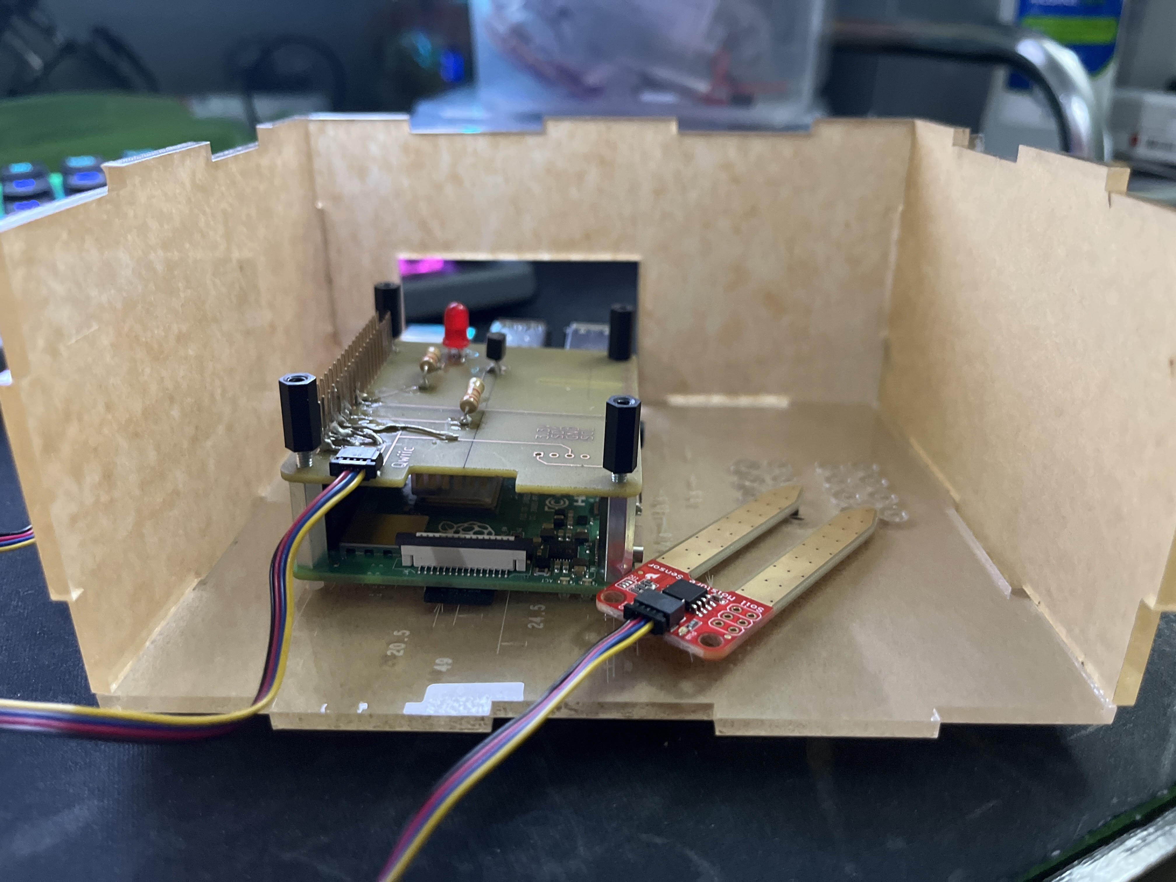
Enclosed Hardware & I2C Address

Slide 3
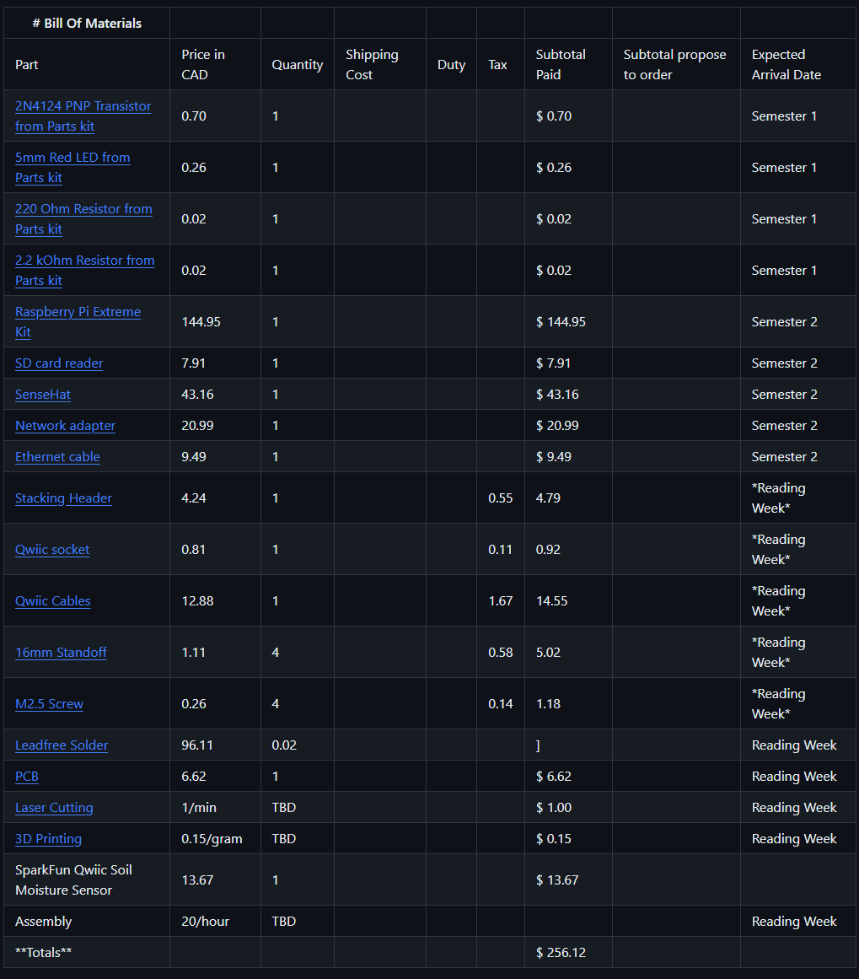
Bill Of Materials
Important Purchases
Stacking Header
Qwiic Socket
Qwiic Cable
16mm Standoff
M2.5 Screw
Soil Moisture Sensor

Slide 4
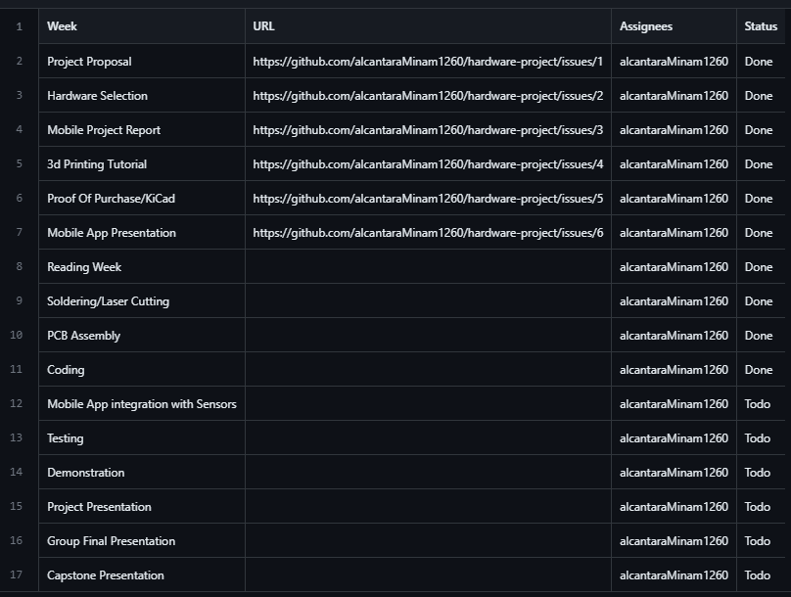
Project Schedule

Slide 5
Reading/Writing To Sensor

Slide 6
Course Knowledge Utilized
TECH 101, CENG150 (Electric Circuits)
TECH 104, CENG 153 (Programming)

